Slide 1

Travel Package Purchase Prediction
By
Lavina Kunder

Slide 2

BACKGROUND
You are a Data Scientist for a tourism company named "Visit with us". The Policy Maker of the company wants to enable and establish a viable business model to expand the customer base.
A viable business model is a central concept that helps you to understand the existing ways of doing the business and how to change the ways for the benefit of the tourism sector. One of the ways to expand the customer base is to introduce a new offering of packages.
Currently, there are 5 types of packages the company is offering - Basic, Standard, Deluxe, Super Deluxe, King. Looking at the data of the last year, we observed that 18% of the customers purchased the packages. However, the marketing cost was quite high because customers were contacted at random without looking at the available information.
The company is now planning to launch a new product i.e. Wellness Tourism Package. Wellness Tourism is defined as Travel that allows the traveler to maintain, enhance or kick-start a healthy lifestyle, and support or increase one's sense of well-being. However, this time company wants to harness the available data of existing and potential customers to make the marketing expenditure more efficient.
You as a Data Scientist at "Visit with us" travel company have to analyze the customers' data and information to provide recommendations to the Policy Maker and Marketing Team.

Slide 3
PROBLEM DEFINITION
Explore and visualize the dataset.
Data Preprocessing.
Analyze the customers' data and information to provide recommendations to the Policy Maker and Marketing Team and also build a model to predict the potential customer who is going to purchase the newly introduced travel package.
To predict which customer is more likely to purchase the newly introduced travel package.
Testing of Assumptions and Model Performance Evaluation of Bagging (bagging classifier, random forest, and decision tree.) and Boosting (Adaboost, gradient boost, xgboost, and stacking classifier) Models.
Model Performance Evaluation
Generate a set of insights and recommendations.

Slide 4
DATA INFORMATION
There are a 4888 rows and 20 columns
There are 7 attributes of type INTEGER.
There is 7 attributes of type FLOAT.
There are 6 attributes of type OBJECT.
TOTAL : 20 Attributes.

Slide 5
DATA PREPROCESSING I
This part of Data Pre-processing is done to understand the DataSet better and for UNIVARIATE and BIVARIATE Exploratory Data Analysis.
Further Data Pre-processing will be done after EDA is complete.
Pre Processing Done :
1) DROP UNNECESSARY COLUMNS (CustomerID)
2) PROCESSING COLUMNS (Discrepancy in Gender Column corrected)

Slide 6
UNIVARIATE ANALYSIS

Slide 7
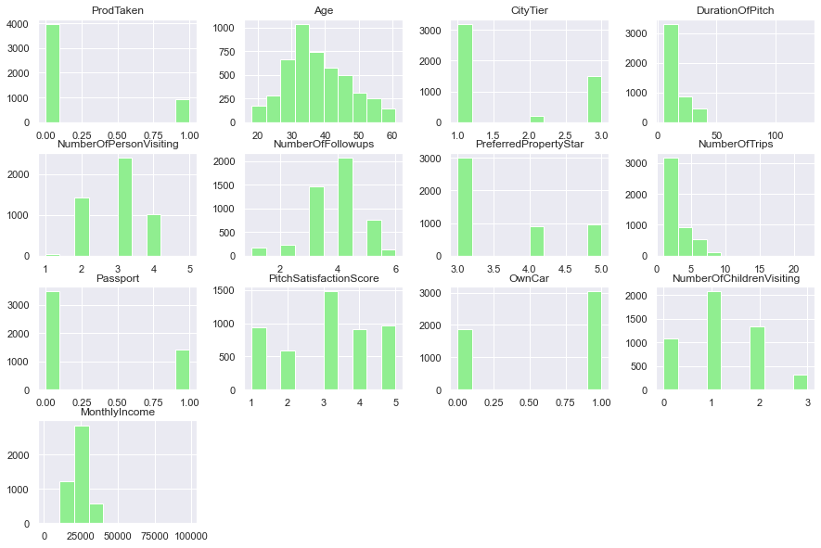
Histogram Plots
Histogram Plots of the various numerical Attributes present in the given Dataset. It shows the frequency of each element within the attribute.

Slide 8
Observations
Age seems to be mostly normally distributed
MonthlyIncome, NumberOfTrips, DurationOfPitch and ProdTaken have very high POSITIVE skew.

Slide 9
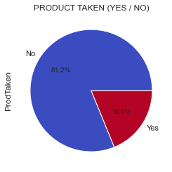
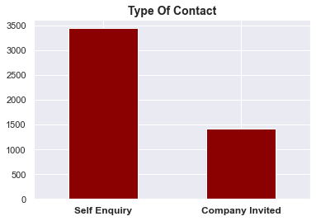
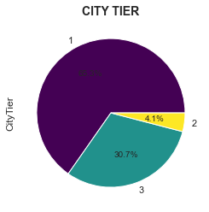
Variable Analysis
Almost 80% of the dataset has not purchased the travel package
Most of the customers are Under Graduates followed by Professionals and Graduates.
Tier 1 has the most number of customers followed by Tier 3 and then by Tier 2.
Ordered based on development; Tier 1 is the most developed followed by Tier 2 and then Tier 3.

Slide 10
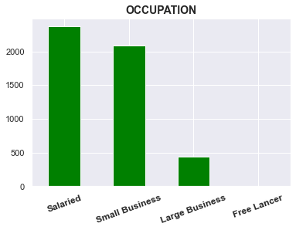
Variable Analysis
Salaried Customers lead the dataset with numbers over 2000 followed by Small Business which also crosses the 2000 mark.
Large Business Customers are third with a little less than 500 people followed by Free Lancers which are very few in number which is why they cannot be depicted on the graph due to the large scale.

Slide 11
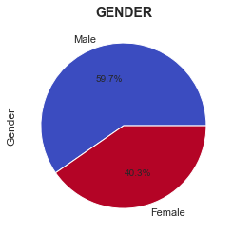
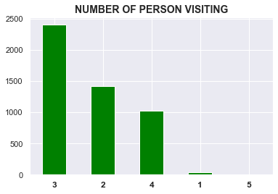
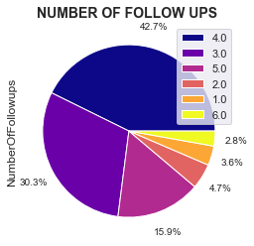
Variable Analysis
Most customers are Male accounting for 60% of the dataset.
Female Customers account for 40% of the dataset.
Most customers have 3 people visiting along with them, with almost 2300 customers. Followed by 2 and 4 people, each of which have customers in the range of 1000 - 1500
Almost 40% of the Dataset has 4 followups done by the sales person It is followed by 3 and 5 followups each accounting for 30% and 16% of the dataset.
2,1 and 6 followups account for less then 10% of the dataset together

Slide 12
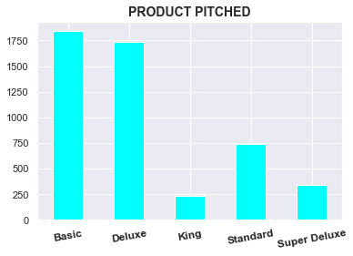
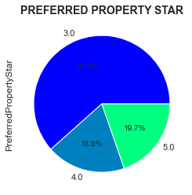
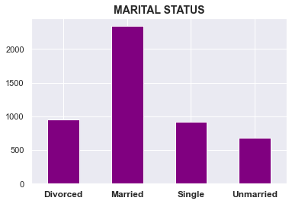
Variable Analysis
Most widely pitched travel package is the Basic Travel Package followed by the Deluxe, King, Standard and Super Deluxe
The most Preferred Property Star is 3 accounting for 61% of the dataset followed by 4 at 18.8% and 5 at 18.7%
Over 2000 customers are married then followed by Divorced and Single which are in the same range
Least number of customers are unmarried.

Slide 13
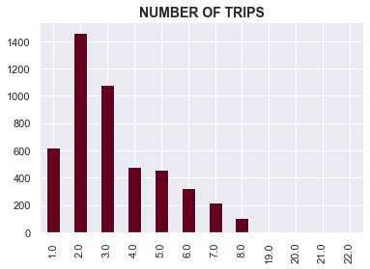
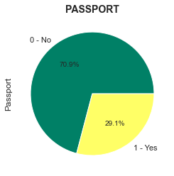
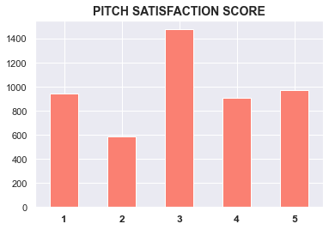
Variable Analysis
Most customers have 2 - 3 annual trips
On the lower range we have 1, 4, 5, 6, 7 and 8 annual trips.
very few customers have 19 - 22 annual trips and the numbers are almost negligible on a large scale.
Most customers do not have a passport accounting for 71% of the dataset.
The most common pitch satisfation score is 3 followed by 5, 1, 4 and 2.

Slide 14
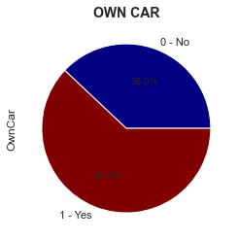
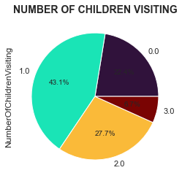
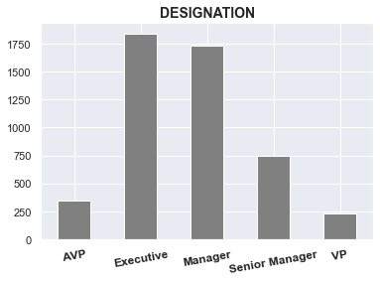
Variable Analysis
62% of the dataset of customers have cars.
Only 38% of customers do not have cars.
Most customers have 1 child visiting along with them followed by no, 2 and 3 children.
Over 1750 customers are executives at their places of work followed by Managers, Senior Managers, AVP and VP

Slide 15
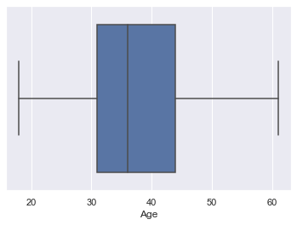
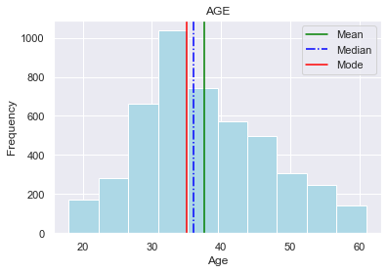
AGE DISTRIBUTION
Age, for the most part, seems to be normally distributed.
Most of the customers are concentrated around the age range of 30 - 40 years.
Mode < Median < Mean
No outliers

Slide 16
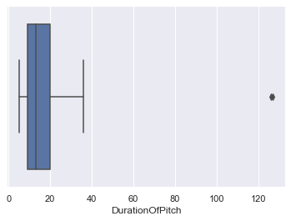
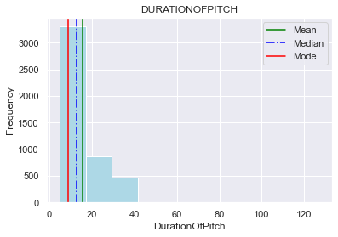
DURATION OF PITCH DISTRIBUTION
Duration of Pitch is highly positive skewed
Mode < Median < Mean
Outliers present

Slide 17
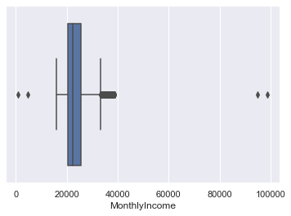
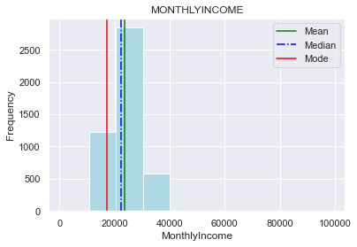
MONTHLY INCOME DISTRIBUTION
Mode < Median < Mean
Monthly Income is mostly concentrated around 10,000 to 40,000
Peaks in the 20,000 to 30,000 range.

Slide 18
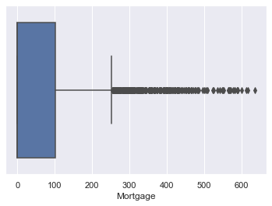
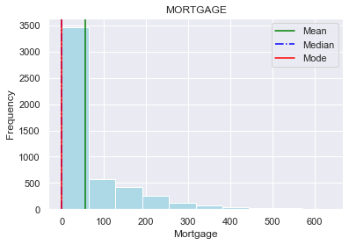
MORTGAGE DISTRIBUTION
Mode = Median < Mean
Most customers have a mortgage spanning 0 to 50,000 dollars
High Postive Skew is visible.

Slide 19
BIVARIATE & MULTIVARIATE ANALYSIS

Slide 20
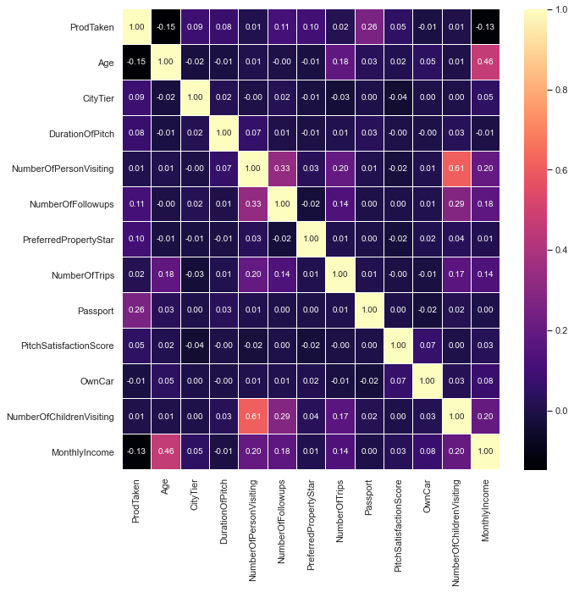
Correlation Heat Map
This Heat Map shows the correlation between the individual attributes. With this we can draw the following inferences :
1) There is distributed correlation between the attributes of this dataset.
2) The Highest Correlation is between 'Number of Children Visiting' and 'Number of Persons Visiting' with 0.61.
3) The Lowest Correlation is between 'Age' and 'ProdTaken' with -0.15 (Negative).
4) Since ProdTaken is our target variable; the correlations of other columns with ProdTaken; like Age, CityTier, DurationofPitch, OwnCar, MonthlyIncome and NumberOfTrips have very low correlations.

Slide 21
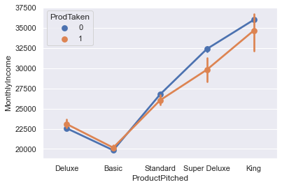
PRODUCTPITCHED v/s MONTHLYINCOME v/s PRODTAKEN
OBSERVATIONS
Customers that were pitched the Basic Package have the lowest Monthly Income.
Across all the products pitched, the number of customers that opted for the package and did not opt for the package are roughly the same with a little discrepancy in Super Deluxe and King Packages.
Customers that were pitched the Super Deluxe and King Packages have the highest monthly income.

Slide 22
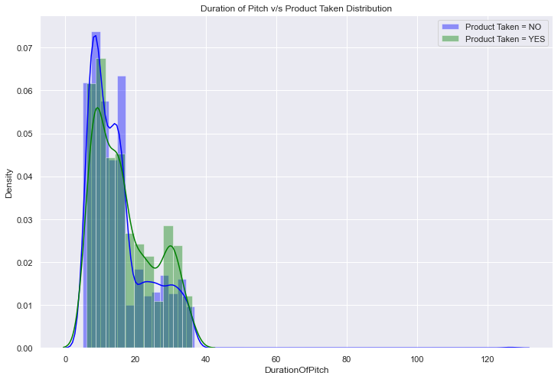
DURATIONOFPITCH v/s PRODTAKEN
OBSERVATIONS
The number of customers that purchased the travel packages decreased with the increase in the duration of pitch.
Duration of pitch in the range of 0 - 20 have the highest number of customers that purchased the travel package.

Slide 23
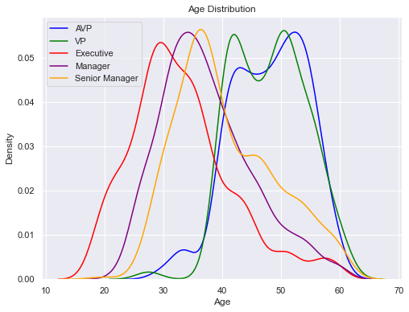
AGE v/s DESIGNATION
OBSERVATIONS
Customers working as Executives are the youngest in the dataset in the lower age range followed by Managers and then by Senior Managers in increasing Age Range order.
VP and AVP have roughly the same age range and account for the older customers on the dataset spanning mostly 40 - 60 years.

Slide 24
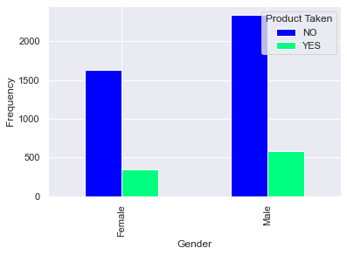
GENDER v/s PRODUCT TAKEN
OBSERVATIONS
Male customers purchase the travel packages more than Female ones.

Slide 25
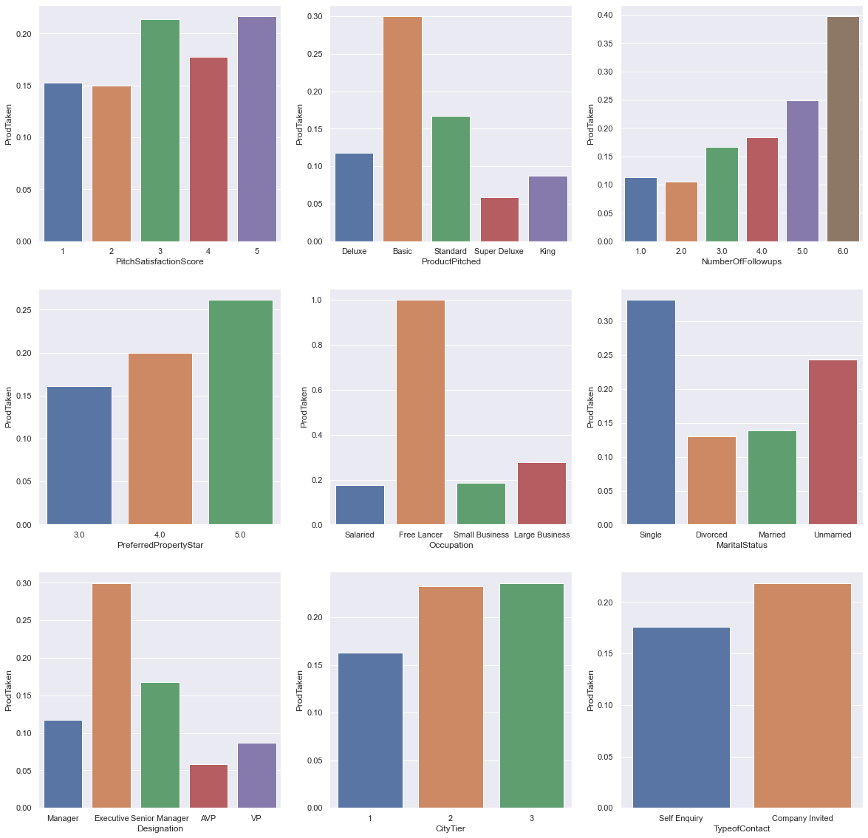
PRODTAKEN v/s OTHER ATTRIBUTES
OBSERVATIONS
The graphs average the numbers for the customers that have taken the travel package with those who don't across all atrributes and their subdivisions.

Slide 26
PRODTAKEN v/s OTHER ATTRIBUTES
OBSERVATIONS
Pitch Satisfaction score of 3 and 5 have higher number of customers that have purchased the travel packages
Basic Packages are the most attractive products with most customers preferring the same
An increase in the number of follow ups results in the increase of purchase of travel packages purchased.
Preferred property star of 5 has the most number of products taken.
ALL customers who work as free lancers have purchased the travel packages.
Single Customers account for the people that purchase the most travel packages.
Executives account for the people that purchase the most travel packages.
Despite most people living in the City Tier 1 and having better facilities, they purchase the least amount of packages.
When the customer is company invited, they are more likely to purchase travel packages.

Slide 27
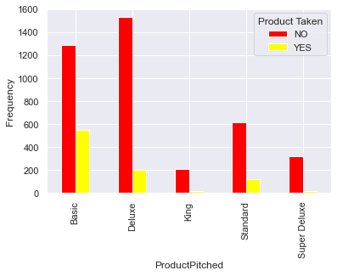
PRODUCT PITCHED v/s PRODUCT TAKEN
OBSERVATIONS
King and Super Deluxe Packages have very few customers that have purchased them and they are also pitched far less that the others. This may be due to the higher prices of these packages.
Deluxe has the highest number of pitches but is the 3rd least purchased package.
Basic package has the highest number of customers that have purchased it.

Slide 28
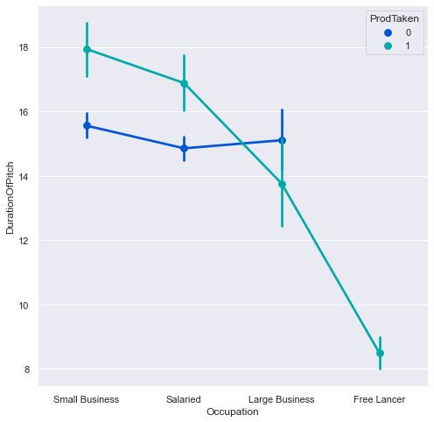
OCCUPATION v/s DURATION OF PITCH
OBSERVATIONS
Customers that are Free Lancers have all purchased travel packages.
Customers that have Small Business are the ones that purchase travel packages with the highest Duration of Pitch followed by Salaried Customers, Large Business Customers and then Free Lancers.
For customers that do not purachase the packages, the duration of pitch lasts in the range of 14 to 16

Slide 29
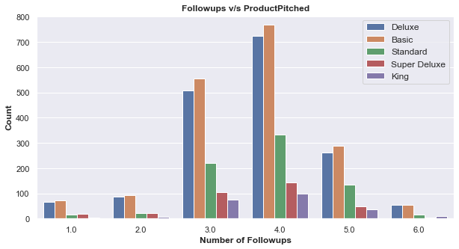
NUMBER OF FOLLOWUPS v/s PRODUCT PITCHED
OBSERVATIONS
Deluxe, Basic and Standard packages mostly have follow ups in the range of 3 to 5.
King packages only have followups in the range of 3 - 6
Super Deluxe has follow ups in the range of 1 - 5

Slide 30
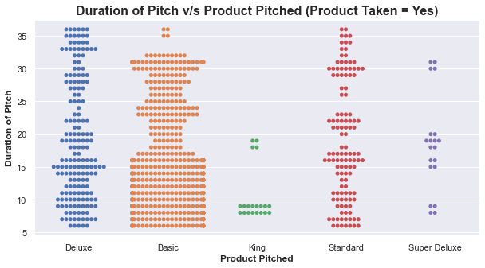
DURATION OF PITCH v/s PRODUCT PITCHED WHERE PRODUCT TAKEN = YES
OBSERVATIONS
Basic, Deluxe and Standard packages have a mostly even distribution of duration of pitch while King and Super Deluxe have specific pitch durations.
Most of the Basic Packages purchased have a duration of pitch in the range of 5 - 16.

Slide 31
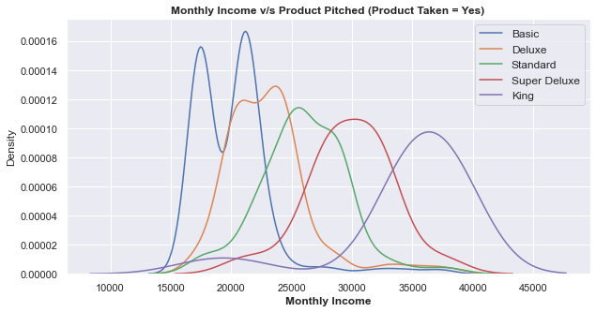
MONTHLY INCOME v/s PRODUCT PITCHED WHERE PRODUCT TAKEN = YES
OBSERVATIONS
Customers that purchased the Basic Packages have the lowest Monthly Income followed by Deluxe, Standard, Super Deluxe and King in increasing order of Monthly Income.
Basic : 15000 - 25000
Deluxe : 17,500 - 27,500
Standard : 20,000 - 32,000
Super Deluxe : 25,000 - 35,000
King : 30,000 - 42,500

Slide 32
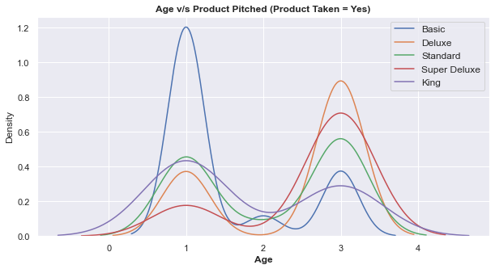
AGE v/s PRODUCT PITCHED WHERE PRODUCT TAKEN = YES
OBSERVATIONS
Tier 1 : Customers from this tier purchase basic packages the most followed by Standard and King in almost equal numbers. Deluxe is next and the Super Deluxe packages with the least number of purchases.
Tier 2 : There are very few customers from this tier. The Order of packages purchased from those pitched to them in descending order is : King > Basic > Standard > Super Deluxe > Deluxe
Tier 3 : The Order of packages purchased from those pitched to them in descending order is : Deluxe > Super Deluxe > Standard > Basic > King

Slide 33
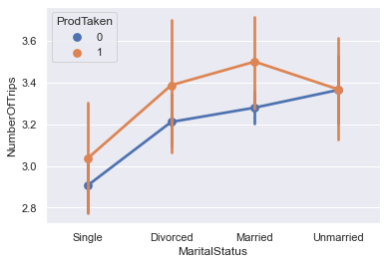
NUMBER OF TRIPS v/s MARITAL STATUS WHERE PRODUCT TAKEN = YES
OBSERVATIONS
Single, Divorced and Married customers that have purchased travel packages are more than those who have not.
Unmarried customers have equal number of people who have purchased and not purchased travel packages.

Slide 34
Key Insights based on EDA
Age seems to be mostly normally distributed
MonthlyIncome, NumberOfTrips, DurationOfPitch and ProdTaken have very high POSITIVE skew.
Age, for the most part, seems to be normally distributed.
Most of the customers are concentrated around the age range of 30 - 40 years.
Duration of Pitch is highly positive skewed
Monthly Income is mostly concentrated around 10,000 to 40,000
Monthly Income Peaks in the 20,000 to 30,000 range.
Almost 80% of the dataset has not purchased the travel package
Most customers found about the travel packages on self inquiry rather than company invited
Tier 1 has the most number of customers followed by Tier 3 and then by Tier 2.

Slide 35
Key Insights based on EDA
Ordered based on development; Tier 1 is the most devloped followed by Tier 2 and then Tier 3.
Salaried Customers lead the dataset with numbers over 2000 followed by Small Business which also crosses the 2000 mark.
Large Business Customers are third with a little less than 500 people followed by Free Lancers which arevery few in number which is why they cannot be depicted on the graph due to the large scale.
Most customers are Male accounting for 60% of the dataset.
Female Customers account for 40% of the dataset.
Most customers have 3 people visiting along with them, accounting for almost 2300 customers.
Followed by 2 and 4 people, each of which have customers in the range of 1000 - 1500
Almost 40% of the Dataset has 4 followups done by the sales person
It is followed by 3 and 5 followups each accounting for 30% and 16% of the dataset.

Slide 36
Key Insights based on EDA
2,1 and 6 followups account for less then 10% of the dataset together
Most widely pitched travel package is the Basic Travel Package followed by the Deluxe, King, Standard and Super Deluxe
The most Preferred Property Star is 3 accounting for 61% of the dataset followed by 4 at 18.8% and 5 at 18.7%
Over 2000 customers are married then followed by Divorced and Single which are in the same range
Least number of customers are unmarried.
Most customers have 2 - 3 annual trips
On the lower range we have 1, 4, 5, 6, 7 and 8 annual trips.
very few customers have 19 - 22 annual trips and the numbers are almost negligible on a large scale.
Most customers do not have a passpirt accounting for 71% of the dataset.
The most common pitch satisfation score is 3 followed by 5, 1, 4 and 2.

Slide 37
Key Insights based on EDA
62% of the dataset of customers have cars.
Most customers have 1 child visiting along with them followed by no, 2 and 3 children.
Over 1750 customers are excutives at their places of work followed by Managers, Senior Managers, AVP and VP
The Highest Correlation is between 'Number of Children Visiting' and 'Number of Persons Visiting' with 0.61.
The Lowest Correlation is between 'Age' and 'ProdTaken' with -0.15 (Negative).
Since ProdTaken is our target variable; the correlations of other columns with ProdTaken; like Age, CityTier, DurationofPitch, OwnCar, MonthlyIncome and NumberOfTrips have very low correlations.
Customers that were pitched the Basic Package have the lowest Monthly Income.
Across all the products pitched, the number of customers that opted for the package and did not opt for the package are roughly the same with a little discrepancy in Super Deluxe and King Packages.

Slide 38
Key Insights based on EDA
Customers that were pitched the Super Deluxe and King Packages have the highest monthly income.
The number of customers that puchased the travel packages decreased with the increase in the duration of pitch.
Duration of pitch in the range of 0 - 20 have the highest number of customers that purchased the travel package.
Customers working as Executives are the youngest in the dataset in the lower age range followed by Managers and then by Senior Managers in increasing Age Range order.
VP and AVP have roughly the same age range and account for the older customers on the dataset spanning mostly 40 - 60 years.
An increase in the number of follow ups results in the increase of purchase of travel packages purchased.
Preferred property star of 5 has the most number of products taken.
Despite most people living in the City Tier 1 and having better facilities, they purchase the least amount of packages.
When the customer is company invited, they are more likely to purchase travel packages.

Slide 39
Key Insights based on EDA
King and Super Deluxe Packages have very few customers that have purchased them and they are also pitched far less that the others. This may be due to the higher prices of these packages.
Customers that have Small Business are the ones that purchase travel packages with the highest Duration of Pitch followed by Salaried Customers, Large Business Customers and then Free Lancers.
For customers that do not purachase the packages, the duration of pitch lasts in the range of 14 to 16
Deluxe, Basic and Standard packages mostly have follow ups in the range of 3 to 5.
Single, Divorced and Married customers that have purchased travel packages are more than those who have not.
Unmarried customers have equal number of people who have purchased and not purchased travel packages.

Slide 40
DATA PREPROCESSING II
FEATURE ENGINEERING
This part of Data Preprocessing is done to cater to the Model Building part of the project. It will help in easier development of the Logistic Regression Model and Decision Tree
CONTINUATION : Pre-Processing Done:
3) FIXING MISSING VALUES : Mode and Median were used to fill the missing values in 8 columns
4) FIXING DATA TYPE : Object converted to Category
5) OUTLIERS AND THEIR TREATMENT : Identifying the outliers in all columns and treating them

Slide 41
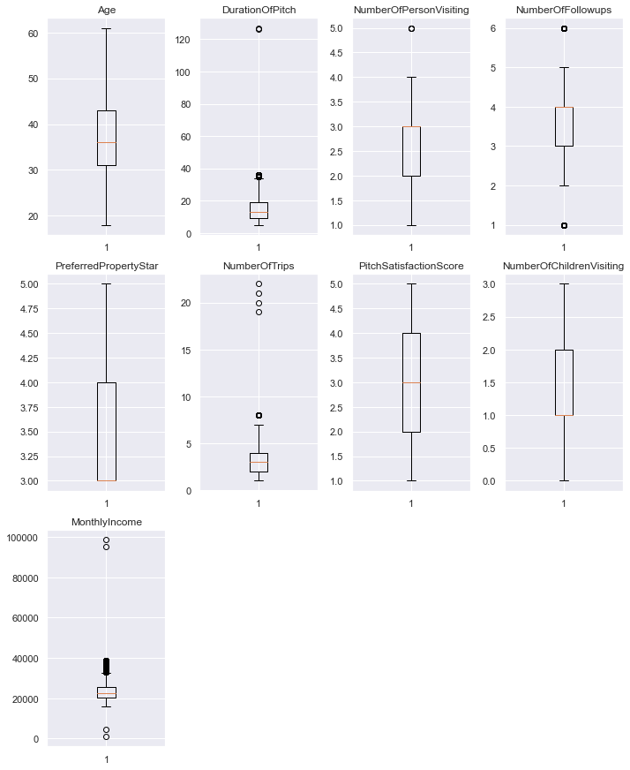
DATA PREPROCESSING II
The outliers will be left untreated as firstly, there aren't many outliers. Secondly, these outliers may prove to be important during the building of the boosting and bagging models.

Slide 42
MODEL BUILDING Bagging

Slide 43
3 Bagging Models were built. Their Confusion Matrices and Performance Metrics are as follows :

Slide 44
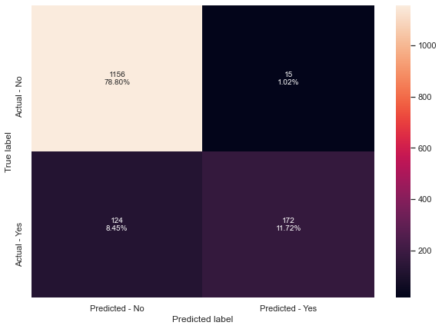
1) BAGGING CLASSIFIER
PERFORMANCE METRICS
Accuracy on training set : 0.9947383805904706
Accuracy on test set : 0.9052488070892979
Recall on training set : 0.9711538461538461
Recall on test set : 0.581081081081081
Precision on training set : 1.0
Precision on test set : 0.9197860962566845
F1-Score on training set : 0.9853658536585366
F1-Score on test set : 0.7122153209109731

Slide 45

2) Random Forest
PERFORMANCE METRICS
Accuracy on training set : 1.0
Accuracy on test set : 0.9086571233810498
Recall on training set : 1.0
Recall on test set : 0.5743243243243243
Precision on training set : 1.0
Precision on test set : 0.9550561797752809
F1-Score on training set : 1.0
F1-Score on test set : 0.7172995780590716

Slide 46
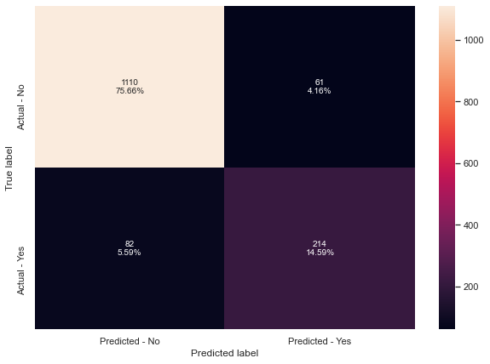
3) Decision Tree
PERFORMANCE METRICS
Accuracy on training set : 1.0
Accuracy on test set : 0.9025221540558964
Recall on training set : 1.0
Recall on test set : 0.722972972972973
Precision on training set : 1.0
Precision on test set : 0.7781818181818182
F1-Score on training set : 1.0
F1-Score on test set : 0.7495621716287216

Slide 47
MODEL PERFORMANCE IMPROVEMENT Bagging

Slide 48
Model Performance Improvement - Bagging
Which metric is right for model performance evaluation?
In this particular case we aim to maximize Recall; the greater the Recall higher the chances of minimizing false negatives because if the model predicts that a customer would not buy a travel package but in reality they do then the company has to take extra measures to ensure they have enough facilities to cater to the people that were misidentified as the facilities will be limited and reserved for those who they expect to purchase the travel packages.

Slide 49
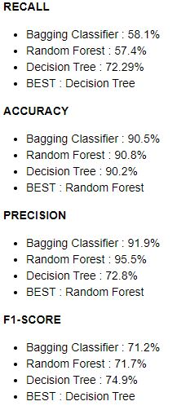
Model Performance Improvement - Bagging
Observations on Model Performance:
Although the accuracy and precision is high scross all the models; the recall is pretty low for the TEST sets across all the bagging models except for Decision Tree for which it is moderate.
We can use Hyperparameter Tuning to improve the Model Performance.

Slide 50
MODEL PERFORMANCE IMPROVEMENT Hyper Parameter Tuning - Bagging

Slide 51
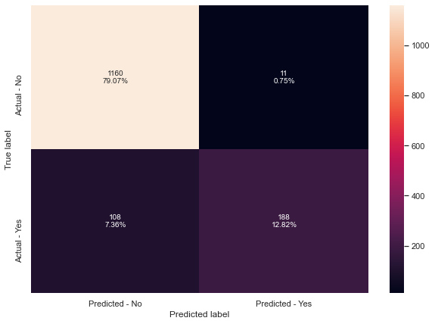
1) BAGGING CLASSIFIER
TUNED PERFORMANCE METRICS
Accuracy on training set : 0.9988307512423268
Accuracy on test set : 0.9188820722563054
Recall on training set : 0.9935897435897436
Recall on test set : 0.6351351351351351
Precision on training set : 1.0
Precision on test set : 0.9447236180904522
F1-Score on training set : 0.9967845659163987
F1-Score on test set : 0.7595959595959595

Slide 52

2) Random Forest
TUNED PERFORMANCE METRICS
Accuracy on training set : 1.0
Accuracy on test set : 0.918200408997955
Recall on training set : 1.0
Recall on test set : 0.6283783783783784
Precision on training set : 1.0
Precision on test set : 0.9489795918367347
F1-Score on training set : 1.0
F1-Score on test set : 0.7560975609756098

Slide 53
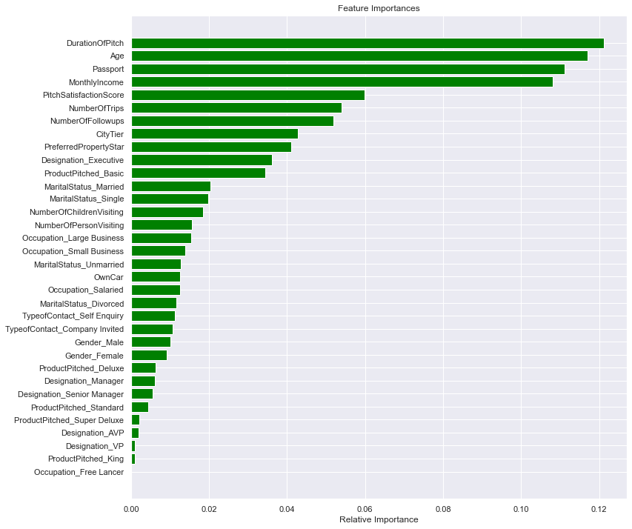
2) Random Forest
FEATURE IMPORTANCE
For the Random Forest Model, the features with the highest importance are :
DurationofPitch > Age > Passport > MonthlyIncome

Slide 54
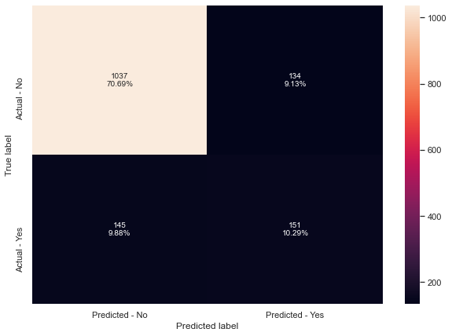
3) Decision Tree
TUNED PERFORMANCE METRICS
Accuracy on training set : 0.8275358082432037
Accuracy on test set : 0.8098159509202454
Recall on training set : 0.5785256410256411
Recall on test set : 0.5101351351351351
Precision on training set : 0.5247093023255814
Precision on test set : 0.5298245614035088
F1-Score on training set : 0.5503048780487805
F1-Score on test set : 0.5197934595524957

Slide 55
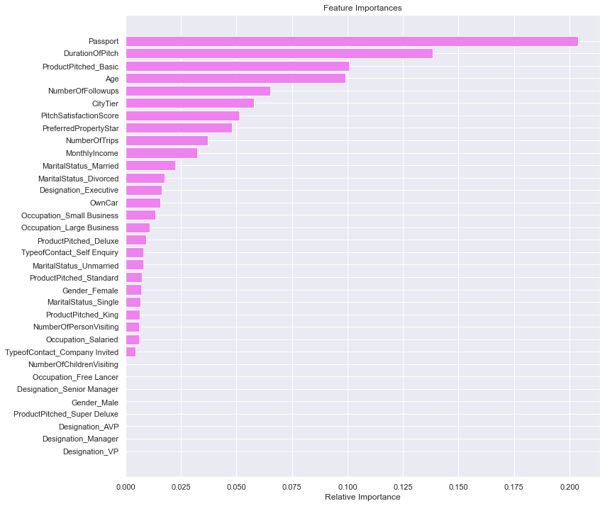
2) Decision Tree
FEATURE IMPORTANCE
For the Decision Tree Model, the features with the highest importance are :
Passport > DurationofPitch > ProductPitched_Basic > Age

Slide 56
MODEL PERFORMANCE IMPROVEMENT Comparing Models - Bagging

Slide 57
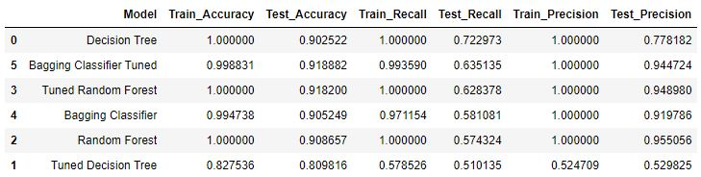
Comparing the Models - Bagging
OBSERVATIONS
From this table we can see that Decision Tree without tuning has given the best Recall for the test set, but we can note that it's Precision is quite low.
Tuned Bagging Classifier has very good Accuracy and Precision score with its recall having increased after tuning, although not by much.
Decision Tree is the only one that saw a fall in the recall value after tuning whereas recall values increased for the other 2 methods after tuning.
BEST MODEL - Bagging Classifier Tuned

Slide 58
MODEL BUILDING Boosting

Slide 59
4 Boosting Models were built. Their Confusion Matrices and Performance Metrics are as follows :

Slide 60
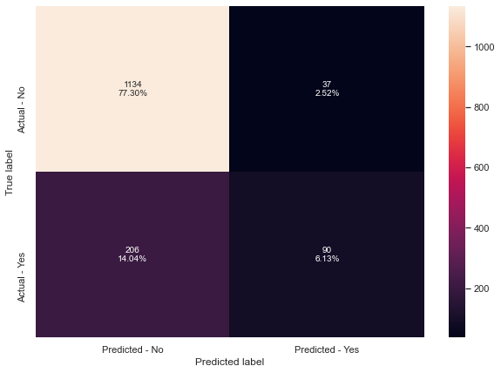
1) Adaboost Model
PERFORMANCE METRICS
Accuracy on training set : 0.8544285296696872
Accuracy on test set : 0.8343558282208589
Recall on training set : 0.34134615384615385
Recall on test set : 0.30405405405405406
Precision on training set : 0.71
Precision on test set : 0.7086614173228346
F1-Score on training set : 0.4610389610389611
F1-Score on test set : 0.425531914893617

Slide 61

2) Gradient Boost
PERFORMANCE METRICS
Accuracy on training set : 0.889505992399883
Accuracy on test set : 0.858214042263122
Recall on training set : 0.4823717948717949
Recall on test set : 0.3716216216216216
Precision on training set : 0.8455056179775281
Precision on test set : 0.8333333333333334
F1-Score on training set : 0.6142857142857143
F1-Score on test set : 0.514018691588785

Slide 62

3) XGBoost
PERFORMANCE METRICS
Accuracy on training set : 1.0
Accuracy on test set : 0.9270620313565099
Recall on training set : 1.0
Recall on test set : 0.6790540540540541
Precision on training set : 1.0
Precision on test set : 0.9436619718309859
F1-Score on training set : 1.0
F1-Score on test set : 0.7897838899803536

Slide 63

4) Stacking classifier
PERFORMANCE METRICS
Accuracy on training set : 1.0
Accuracy on test set : 0.9325153374233128
Recall on training set : 1.0
Recall on test set : 0.7601351351351351
Precision on training set : 1.0
Precision on test set : 0.8893280632411067
F1-Score on training set : 1.0
F1-Score on test set : 0.8196721311475409

Slide 64
MODEL PERFORMANCE IMPROVEMENT Boosting

Slide 65
Model Performance Improvement - Bagging
Which metric is right for model performance evaluation?
In this particular case we aim to maximize Recall; the greater the Recall higher the chances of minimizing false negatives because if the model predicts that a customer would not buy a travel package but in reality they do then the company has to take extra measures to ensure they have enough facilities to cater to the people that were misidentified as the facilities will be limited and reserved for those who they expect to purchase the travel packages.

Slide 66
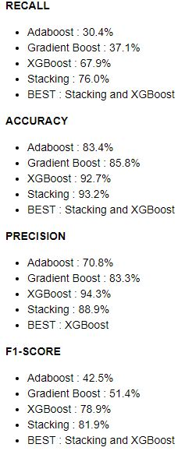
Model Performance Improvement - Bagging
Observations on Model Performance:
As we can see, the recall is pretty low for the TEST sets in Adaboost and Gradient Boost. XGBoost has moderate recall and stacking performance is higher which is expected as it used 4 other models to derive it's score.
We can use Hyperparameter Tuning to improve the Model Performance.

Slide 67
MODEL PERFORMANCE IMPROVEMENT Hyper Parameter Tuning - Boosting

Slide 68

1) Adaboost
TUNED PERFORMANCE METRICS
Accuracy on training set : 0.9821689564454837
Accuracy on test set : 0.8882072256305386
Recall on training set : 0.9262820512820513
Recall on test set : 0.6216216216216216
Precision on training set : 0.9747048903878583
Precision on test set : 0.7796610169491526
F1-Score on training set : 0.9498767460969598
F1-Score on test set : 0.6917293233082706

Slide 69
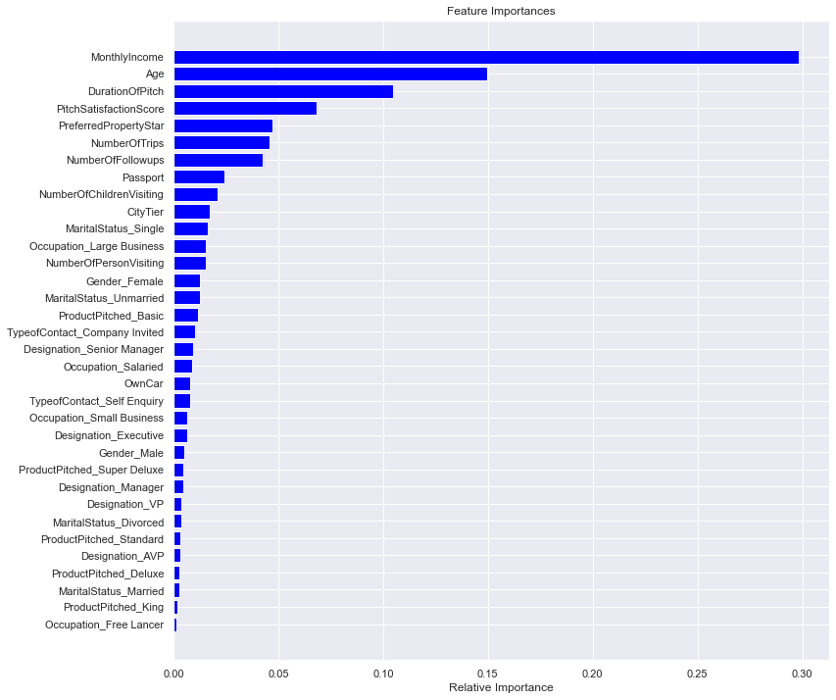
1) Adaboost
FEATURE IMPORTANCE
For the Adaboost Model, the features with the highest importance are :
MonthlyIncome > Age > DurationOfPitch > PitchSatisfactionScore

Slide 70

2) Gradient boost
TUNED PERFORMANCE METRICS
Accuracy on training set : 0.9155217772581117
Accuracy on test set : 0.8698023176550784
Recall on training set : 0.5993589743589743
Recall on test set : 0.4358108108108108
Precision on training set : 0.9055690072639225
Precision on test set : 0.8431372549019608
F1-Score on training set : 0.721311475409836
F1-Score on test set : 0.5746102449888641

Slide 71

2) Gradient boost
FEATURE IMPORTANCE
For the Gradient Boost Model, the features with the highest importance are :
MonthlyIncome > Passport > Age > DurationOfPitch

Slide 72

3) XGboost
TUNED PERFORMANCE METRICS
Accuracy on training set : 1.0
Accuracy on test set : 0.9263803680981595
Recall on training set : 1.0
Recall on test set : 0.6959459459459459
Precision on training set : 1.0
Precision on test set : 0.9196428571428571
F1-Score on training set : 1.0
F1-Score on test set : 0.7923076923076924

Slide 73

3) XGboost
FEATURE IMPORTANCE
For the XGBoost Model, the features with the highest importance are :
ProductPitched_Basic > Passport > ProductPitched_Super Deluxe > MaritalStatus_Single

Slide 74

4) Stacking classifier
TUNED PERFORMANCE METRICS
Accuracy on training set : 0.9935691318327974
Accuracy on test set : 0.9297886843899114
Recall on training set : 0.9935897435897436
Recall on test set : 0.7837837837837838
Precision on training set : 0.9717868338557993
Precision on test set : 0.8560885608856088
F1-Score on training set : 0.98256735340729
F1-Score on test set : 0.818342151675485

Slide 75
MODEL PERFORMANCE IMPROVEMENT Comparing Models - Bagging

Slide 76

Comparing the Models - Boosting
OBSERVATIONS
Tuned Stacking Classifier has the best Recall for TEST set of 78% although its precision is low
Tuned XGboost has a recall of 69% with a high precision of 91%
For all models, the recall score increased on tuning but at the cost of some of the other parameters
We can still work on Improving the recall scores across all the models.
Precision and Accuracy values are mostly high across the models so it is not imperative to work on improving them.

Slide 77
ACTIONABLE INSIGHTS & RECOMMENDATIONS

Slide 78
KEY TAKEAWAYS FOR THE BUSINESS / RECOMMENDATIONS
Most of the customers find about travel packages through self inquiry, but it is the ones that are invited by the company itself that are more likely to buy the packages. Therefore, it is important for the company to focus more on inviting people from varied demographics for higher conversion rates of purchase.
Specific packages tailor made for people of varying incomes and designations. Those with lower designations and income can be offered cheaper packages within their budget and more luxurious ones for those with higher incomes and higher designations.
Tier 1 has better facilities and therefore should be more expensive. People living her should be well off, therefore more expensive packages can be marketed here. Yet they have lower number of packages purchased. Their interests can be taken into consideration and packages can be tailor made to those.
Free lancing customers have all purchased packages but are lower in number. Therefore, company can focus more on marketing to them.
Single Customers account for the people that purchase the most travel packages. So specific packages can be further marketed to them.

Slide 79
KEY TAKEAWAYS FOR THE BUSINESS.
Preferred property star of 5 has the most number of products taken. So properties with these ratings should be included more in travel packages.
King and Super Deluxe Packages have very few customers that have purchased them and they are also pitched far less that the others. Some consideration to price can be given here to make it more accessible to people in the slightly lower income range.
The number of customers that purchased the travel packages decreased with the increase in the duration of pitch. Therefore, special care should be given to how long the packages are pitched so as to not disinterest the customers.
Increased follow ups encourage more purchased products so it is imperative to follow up regularly.
Tailored packages corresponding to Age.
International Travel Packages catering to the customers with passports.

Slide 80
THANK YOU

